Slide 1


Deepdive Spatial data - City of Windsor
GROUP # 12
Shubhankar Sudhir Vaidya – W0782520
Dilpreet Singh – W0781536
Sunil Kumar Choudhary – W0783490
Kartik Kalubhai Kotadiya – W0779972

Slide 2
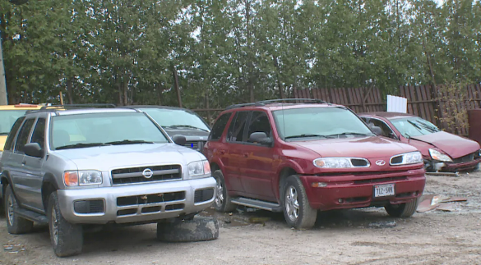
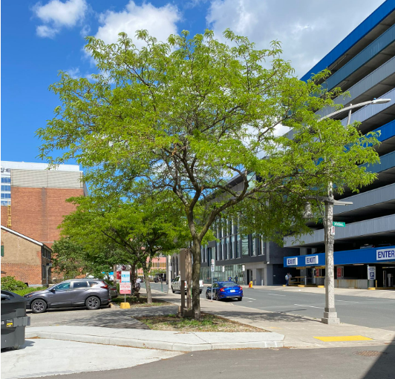
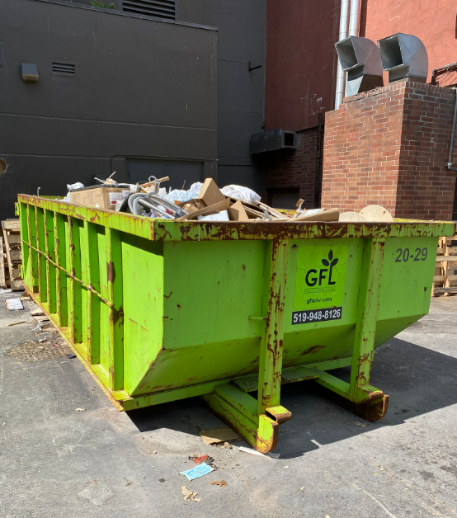
Business Problem – at a glance
Which Wards in Windsor are plagued with what specific non-emergency (things like trash problems, trees down, potholes in the roads) issues and what are the recommendations to mitigate them?

Slide 3
Data source - Overview
311 CRM system’s ALL Service Requests data
Non-emergencies pertaining to public services are reported
Collected via Phone, Email, Online self-serve, Text
Available for public @ https://opendata.citywindsor.ca/
Overall Data
~ 12K rows covering various types of issues
8 columns besides sub-types of nearly 400+ requests
52 types of Service Requests, e.g., Dirty Yard, Road & Sewer maintenance etc.
Requests belong to 9 departments, i.e., ByLaw Enforcement, Environmental service, and Parks Operations etc.
Requests received from 10 Wards across Windsor

Slide 4
Quick synopsis

Slide 5
Quick synopsis
Wards 2, 4 and 3 have been receiving the highest requests on 311 CRM
Wards 8, 9 and 7 have received the least requests
Nearly 17 lines items do not have any Wards mentioned

Slide 6
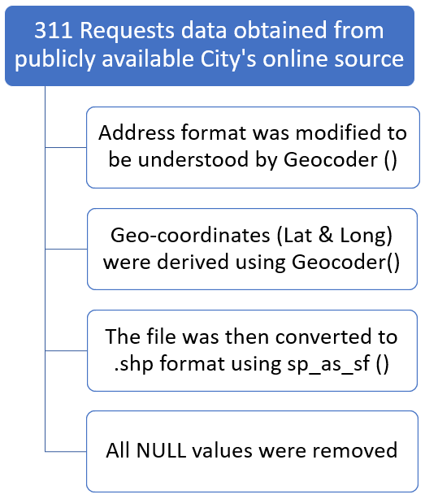
Preprocessing

Slide 7
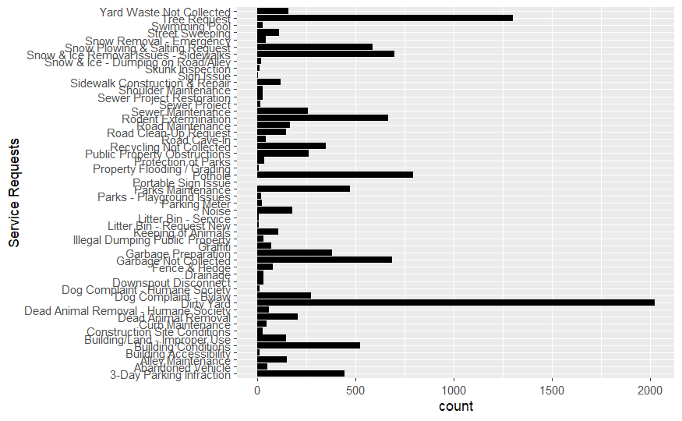
EDA

Slide 8
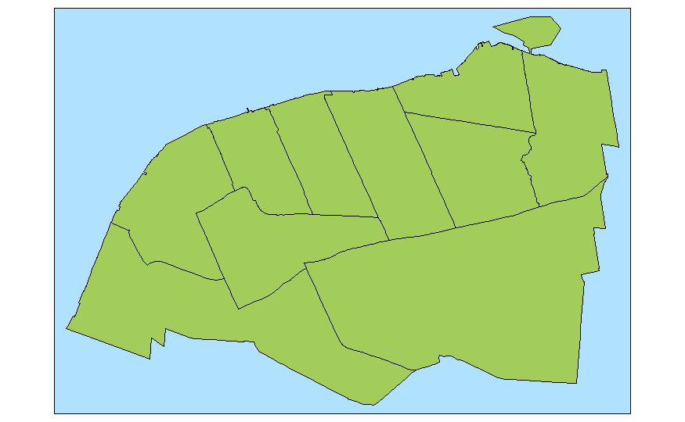
BASE MAP

Slide 9
Next steps
To match the crs of data with windsor data.
Plot top 10 problems using spatial data and see where the problems are more concentrated.
Include other relevant data from windsor open data catalogue and other sources to compare if there is any correlation between two problems.
Provide recommendations (if any) which would result in reduced number of request.

Slide 10
REFERENCES
https://geocompr.robinlovelace.net/index.html
https://towardsdatascience.com/breaking-down-geocoding-in-r-a-complete-guide-1d0f8acd0d4b
UWindsor researcher maps which Windsor neighbourhoods need help accessing vaccines | CBC News
windsor-20-year-plan.pdf (citywindsor.ca)
City cracking down on parking enforcement near schools, following complaints | CBC News

